Slide 1

Bike Sharing Demand Analysis
Nexthikes IT Solution
Dataset B (Final) – Winter 2011 Overview January 1-20, 2011
From: Palvinder Singh

Slide 2
Understanding Our Data
DATASET OVERVIEW
Hourly rental data from a bike-sharing system spanning the first 20 days of January 2011. The dataset captures ~450+ hourly records distinguishing between casual and registered users during winter conditions.
Key Variables: Date, hour (0-23), weekday, temperature (°C), humidity (%), windspeed, weather conditions, and rental counts by user type.
450+
Hourly Records
20
Days Analyzed

Slide 3

Weekday Commuter Patterns
Distinct bimodal distribution reveals clear commuting behavior with two pronounced peaks during rush hours.
1
Morning Peak
7:00-9:00 AM
Commuters heading to work
Example: 154 rentals at 8 AM on Jan 3
2
Midday Lull
10:00 AM-4:00 PM
Reduced activity between peaks
3
Evening Peak
5:00-6:00 PM
Return commute
Example: 212 rentals at 5 PM on Jan 4
4
Night Hours
12:00-5:00 AM
Near-zero activity

Slide 4


Weekend Leisure Patterns
Weekend usage shows a unimodal distribution with a single broad peak, contrasting sharply with weekday patterns.
Slow Morning Start
Afternoon Peak
Activity begins around 10:00 AM
1:00-3:00 PM highest usage 110 rentals on Jan 1 (Sat)
Evening Decline
Gradual decrease after 6:00 PM

Slide 5
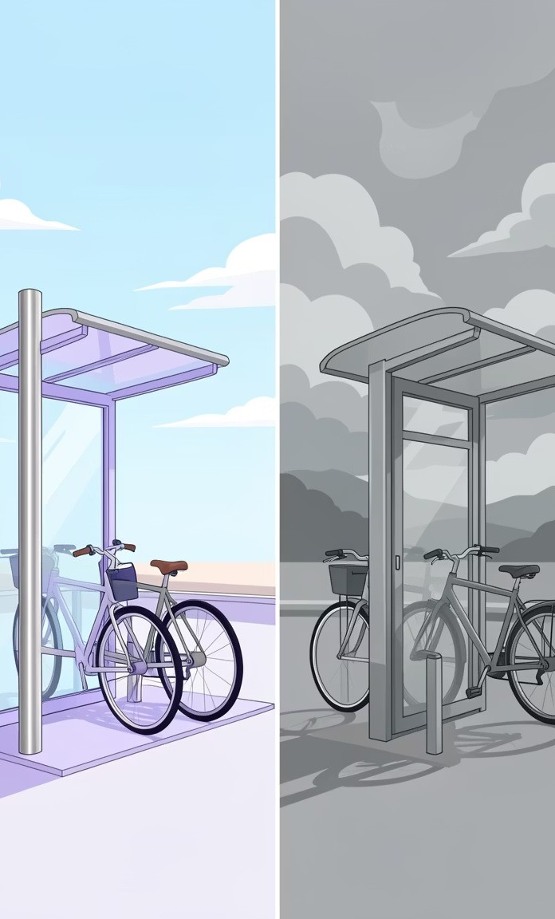



Weather's Powerful Impact
Weather conditions significantly influence rental demand, with clear skies driving the highest usage.
Clear Sky
Highest volume
212 rentals peak on Jan 5 Optimal conditions for cycling
Mist
Moderate volume
110 rentals peak on Jan 1 Users still willing to ride
Dark Cloud
Lowest volume
95 rentals peak on Jan 11 Significant deterrent effect

Slide 6

Temperature & Environmental Factors
Temperature Correlation
Range: 3.28°C to 18.86°C
Positive correlation: As temperature rises, rentals increase significantly.
Cold days (<5°C): <50 rentals/hour
Milder days (>10°C): >150 rentals/hour during peaks
Humidity & Wind Effects
Humidity range: 30%-100%
Optimal range of 40-60% shows consistent high usage. Extreme humidity (>90%) slightly reduces comfort.
Windspeed impact: Higher winds (>0.4) deter casual users. Low wind (0-0.1) optimal for rentals—219 rentals on Jan 6 with zero wind.

Slide 7



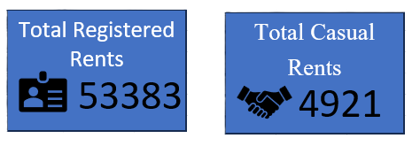
User Segmentation Insights
Registered and casual users exhibit distinctly different rental patterns throughout the week.
Registered Users
Drive commuter peaks Monday-Friday at 8 AM and 5 PM. Comprise 80-90% of weekday volume. Resilient to weather conditions.
Casual Users
Dominate weekend peaks. More sporadic on weekdays. Highly weather-sensitive. Peak during good conditions and lunch hours.

Slide 8
The Holiday Effect
Monday, January 17, 2011
CA STUDY
The holiday dramatically transformed usage patterns, with the typical Monday commuter rush completely vanishing.
Key Takeaway: Registered users significantly reduce usage on holidays, shifting demand to leisure patterns.
Normal Day
Average: 8186 rentals Strong commuter pattern
Holiday Monday: 1000 rentals
Resembled Sunday pattern

Slide 9
Key Findings Summary
Commuter Dominance
The service relies heavily on registered users for weekday commuting, with distinct morning and evening peaks driving the majority of rentals.
Weather Sensitivity
Clear skies and temperatures above 10°C boost ridership significantly. Weather conditions are the strongest predictor of casual user demand.
Weekend Profile
Casual users dominate weekends with peak activity shifted to mid-day (12:00-4:00 PM), creating a distinct leisure usage pattern.
Holiday Behavior
Holidays suppress the morning rush hour spike entirely, shifting demand from business districts to leisure patterns and recreational areas.

Slide 10
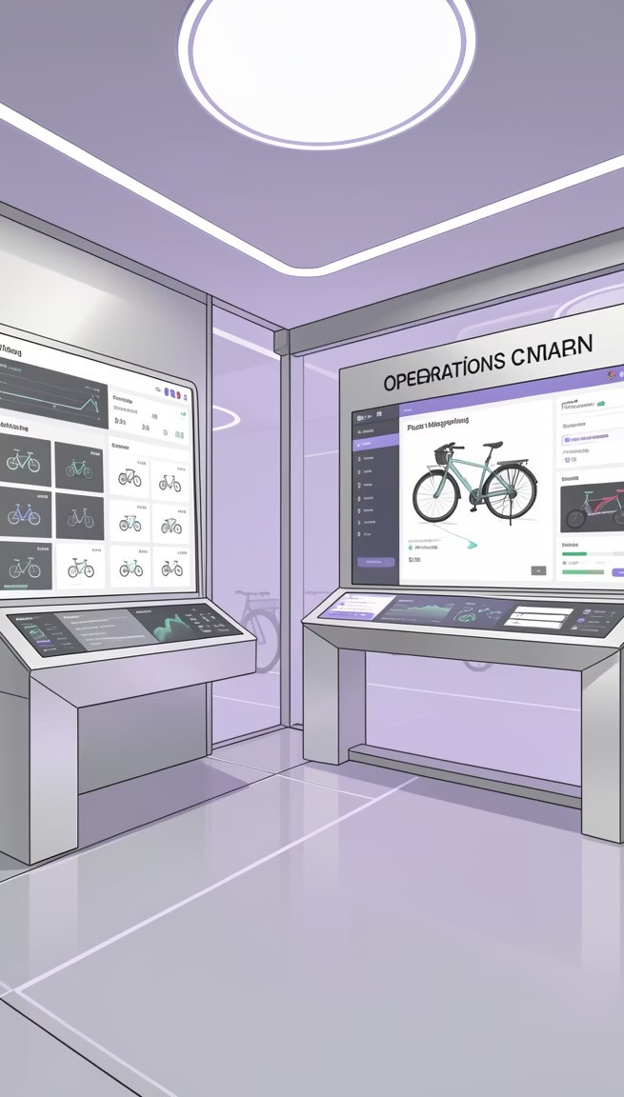
Strategic Recommendations
The dataset reveals healthy utilization with strong sensitivity to weather and work schedules. Here's how to optimize operations:
1
Maintenance Scheduling
Schedule bike maintenance during the low-usage window of 3:00- 5:00 AM to minimize service disruption and maximize fleet availability during peak hours.
2
Targeted Marketing
Target casual users on weekends with promotions when the forecast shows clear skies and temperatures above 12°C to drive leisure usage.
3
Holiday Fleet Distribution
Adjust fleet distribution on holidays from business districts to parks and leisure areas to match the shift from commuter to recreational demand patterns.

Slide 11
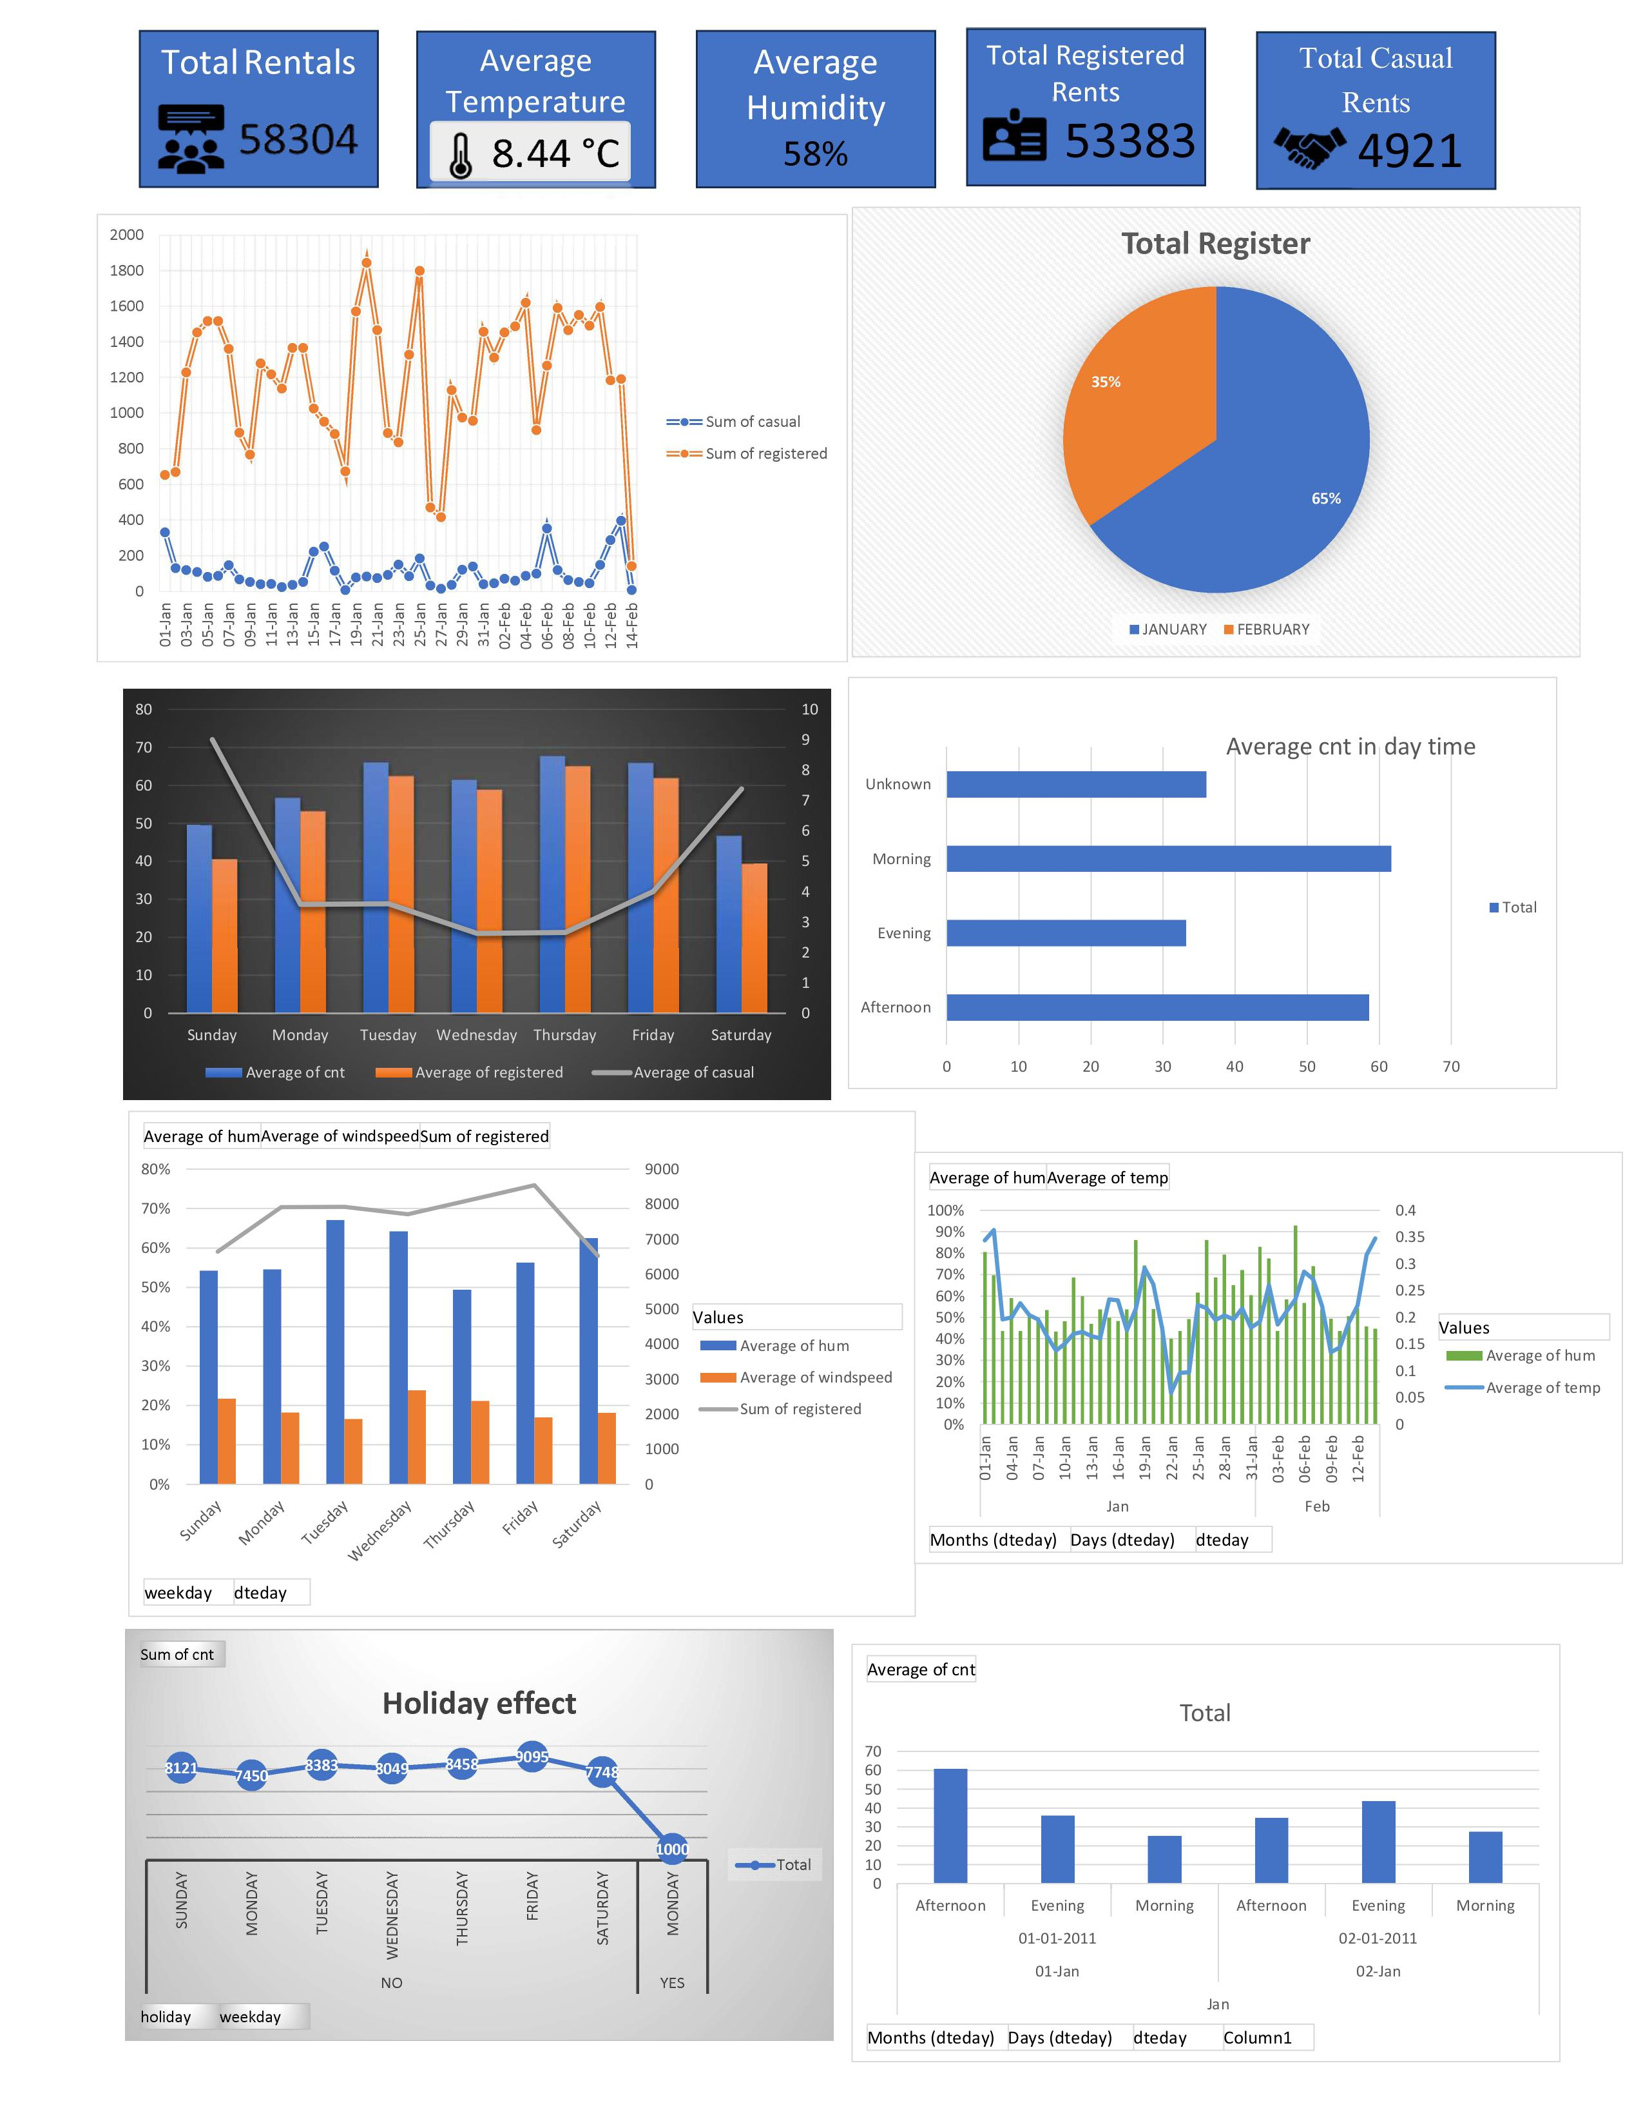
D
A
S
H
B
O
A
R
D

Slide 12
CONCLUSION
    The presented data provides a clear overview of performance metrics.
Key insights help identify strengths and improvement areas.
Visual representation enhances understanding and communication.
This analysis supports informed, strategic decision-making.

Slide 13


